Slide 1

Chapter 3 – Implementing Classes

Slide 2

Chapter Goals
To become familiar with the process of implementing classes
To be able to implement and test simple methods
To understand the purpose and use of constructors
To understand how to access instance variables and local variables
To be able to write javadoc comments

Slide 3

Instance Variables and Encapsulation
Figure 1 Tally counter
Simulator statements:
Counter tally = new Counter(); tally.click();
tally.click();
int result = tally.getValue(); // Sets result to 2
Each counter needs to store a variable that keeps track of the number of simulated button clicks.

Slide 4
Instance Variables
Instance variables store the data of an object.
Instance of a class: an object of the class.
An instance variable is a storage location present in each object of the class.
The class declaration specifies the instance variables:
public class Counter
{
private int value;
...
}
An object's instance variables store the data required for executing its methods.

Slide 5
Instance Variables
An instance variable declaration consists of the following parts:
access specifier (private) type of variable (such as int)
name of variable (such as value)
You should declare all instance variables as private.

Slide 6
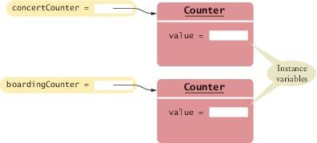
Instance Variables
Each object of a class has its own set of instance variables.
Figure 2 Instance Variables

Slide 7
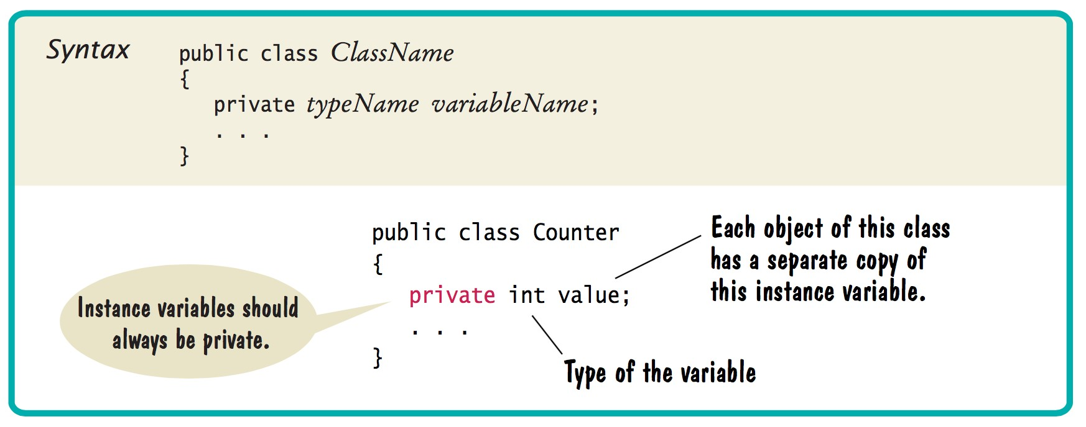
Syntax 3.1 Instance Variable Declaration

Slide 8
The Methods of the Counter Class
The click method advances the counter value by 1:
public void click()
{
value = value + 1;
}
Affects the value of the instance variable of the object on which the method is invoked
The method call concertCounter.click();
Advances the value variable of the concertCounter object

Slide 9
The Methods of the Counter Class
The getValue method returns the current value:
The return statement
Terminates the method call
Returns a result (the return value) to the method's caller
Private instance variables can only be accessed by methods of the same class.
public int getValue()
{
return value;
}

Slide 10
Encapsulation
Encapsulation is the process of hiding implementation details and providing methods for data access.
To encapsulate data:
Declare instance variables as private and Declare public methods that access the variables
Encapsulation allows a programmer to use a class without having to know its implementation.
Information hiding makes it simpler for the implementor of a class to locate errors and change implementations.

Slide 11

Encapsulation
A thermostat functions as a "black box" whose inner workings are hidden.
When you assemble classes, like Rectangle and String, into programs you are like a contractor installing a thermostat.
When you implement your own classes you are like the manufacturer who puts together a thermostat out of parts.

Slide 12
section_1/Counter.java
1 /**
2 This class models a tally counter.
3 */
4 public class Counter
5 {
6 private int value;
7
8 /**
9 Gets the current value of this counter.
10 @return the current value
11 */
12 public int getValue()
13 {
14 return value;
15 }
16
17 /**
18 Advances the value of this counter by 1.
19 */
20 public void click()
21 {
22 value = value + 1;
23 }
24
25 /**
26 Resets the value of this counter to 0.
27 */
28 public void reset()
29 {
30 value = 0;
31 }
32 }

Slide 13
Modeling a Class: Ice Cream Cone
Attributes of an IceCreamCone class:
Ice Cream Flavor
Number of Scoops
Type of cone (sugar, waffle, etc.)
Functions of an Ice Cream Cone:
add a scoop
specify the cone type
Change the flavor
Tell me about the cone you have

Slide 14
Specifying the Public Interface of a Class: Methods
Methods of IceCreamCone class:
addScoop
setFlavor
getConeType
We want to support method calls such as the following:
myCone.addScoop(); myCone.setFlavor(“Chocolate”); System.out.println(mycone.getConeType());

Slide 15
Specifying the Public Interface of a Class: Method Declaration
access specifier (such as public)
return type (such as String or void)
method name (such as setFlavor)
list of parameters (String flv for setFlavor)
method body in { }
Examples:
public void setFlavor(String flv) { . . . }
public void addScoop() { . . . }
public String getConeType() { . . . }

Slide 16
Specifying the Public Interface of a Class: Constructor Declaration
A constructor initializes the instance variables
Constructor name = class name
public IceCreamCone()
{
// body--filled in later
}
Constructor body is executed when new object is created
Statements in constructor body will set the internal data of the object that is being constructed
All constructors of a class have the same name
Compiler can tell constructors apart because they take different parameters

Slide 17
IceCreamCone Public Interface
The public constructors and methods of a class form the public interface of the class:
public class IceCreamCone
{
// private variables--filled in later
// Constructors public IceCreamCone()
{
// body--filled in later
}
public IceCreamCone(double int ns,String flv,String cone)
{
// body--filled in later
}

Slide 18
IceCreamCone Public Interface
// Methods
public void setFlavor(String flv)
{
// body--filled in later
}
public void addScoop()
{
// body--filled in later
}
public double getFlavor()
{
// body--filled in later
}
//Additional methods: setConeType(), getConeType(),
//getNumberOfScoops(), toString()
}

Slide 19
Constructor Call Example
Statement:
IceCreamCone myCone = new IceCreamCone(2,”vanilla”,”sugar”);
Create a new object of type IceCreamCone
Call the second constructor (because construction parameters are supplied in the constructor call)
Set the instance variable numberOfScoops to 2
Set the instance variable flavor to “vanilla”
Return an object reference, that is, the memory location of the object, as the value of the new expression
Store that object reference in the myCone variable

Slide 20
Implementing Methods
addScoop method:
public void addScoop()
{
numberOfScoops=numberOfScoops+1;;
}
getNumberOfScoops method:
public String getNumberOfScoops()
{
return numberOfScoops;;
}

Slide 21
Method Call Example
Statement:
myCone.addScoop();
Increase the value of the instance variable numberOfScoops to by 1
This will store the sum in the numberofScoops instance variable, overwriting the old value
Statement:
int scoops = myCone.getNumberOfScoops();
Retrieve the value of the instance variable numberOfScoops
This will store the value in the scoops local variable

Slide 22
Implementing Methods
public void setFlavor(String flv)
{
flavor=flv;
}
public String getFlavor()
{
return flavor;
}
public void setTypeOfCone(String cone)
{
typeOfCone=cone;
}
public String getTypeOfCone()
{
return typeOfCone;
}

Slide 23
IceCreamCone.java
/* This class is used to model the properties and behaviors of an ice cream cone.
There are currently restriction on the construction of the cone: only one
flavor of ice cream is allowed and no toppings. You can only add scoops, you
cannot remove them. */
public class IceCreamCone {
private int numberOfScoops;
private String flavor;
private String typeOfCone;
//the default constructor creates a one scoop, vanilla ice cream cone using the regular type of cone */
public IceCreamCone() {
numberOfScoops=1;
flavor="vanilla";
typeOfCone="regular";
}

Slide 24
IceCreamCone.java
/*this constructor lets you create an ice cream code to your liking. It takes in three parameters:
the number of scoops, the flavor of the ice cream and the type of cone */
public IceCreamCone(int ns,String flv,String cone) {
numberOfScoops=ns;
flavor=flv;
typeOfCone=cone;
}
//this method returns the number of scoops in the cone
public int getNumberOfScoops () {
return numberOfScoops;
}
//this method returns the ice cream flavor
public String getFlavor() {
return flavor;
}
//this method returns the type of cone
public String getTypeOfCone() {
return typeOfCone;
}
Continued

Slide 25
IceCreamCone.java
//this method allows you to add one scoop of ice cream at a time
public void addScoop() {
numberOfScoops=numberOfScoops+1;
}
//this method allows you to change the ice cream flavor
public void setFlavor(String flv) {
flavor=flv;
}
//this method allows you to change the type of cone
public void setTypeOfCone(String cone) {
typeOfCone=cone;
}
//this method overrides the inherited toString()
public String toString() {
return ("The number of scoops is " + numberOfScoops + ". The flavor is " +
flavor + ". And the type of cone is " + typeOfCone);
}
}
Continued

Slide 26
toString() method
Every class inherits a few methods from the java.lang.Object class (the parent of all Objects). Among these are:
toString() – used to describe the object
equals() – used to determine if two objects are equals
hashCode() – used to compare objects
These methods don’t always work the way you want them to so you might need to override them so they do what you want them to do.
For Example, if we don’t override the toString() method in the IceCreamCone class, System.out.println(myCone) will display
IceCreamCone@1242719c
The number of scoops is 2. The flavor is chocolate. And the type of cone is sugar
//this method overrides the inherited toString()
public String toString() {
return ("The number of scoops is " + numberOfScoops + ". The flavor is " +
flavor + ". And the type of cone is " + typeOfCone);
}
}
Continued

Slide 27
Unit Testing
Unit test: Verifies that a class works correctly in isolation, outside a complete program
To test a class, use an environment for interactive testing, or write a tester class
Tester class: A class with a main method that contains statements to test another class
Typically carries out the following steps:
Construct one or more objects of the class that is being tested
Invoke one or more methods
Print out one or more results
Print the expected results
Continued

Slide 28
Unit Testing
/* This class is used to test the functionality of the IceCreamCone class */
public class IceCreamConeTester {
public static void main(String [] args) {
IceCreamCone ICC = new IceCreamCone();
System.out.println("The new cone is: " + ICC);
IceCreamCone ICC2 = new IceCreamCone(2,"chocolate","sugar");
System.out.println("Cone 2 is: " + ICC2);
ICC.setFlavor("strawberry");
System.out.println("The flavor of cone one is now " + ICC.getFlavor());
ICC.setTypeOfCone("waffle");
System.out.println("The type of cone one is now " + ICC.getTypeOfCone());
ICC2.addScoop();
System.out.println("The number of scoops in cone 2 is now " + ICC2.getNumberOfScoops());
}
}
Continued

Slide 29
Unit Testing (cont.)
Details for building the program vary. In most environments, you need to carry out these steps:
Make a new subfolder for your program
Make two files, one for each class
Compile both files
Run the test program

Slide 30
Local Variables
Local variables are declared in the body of a method:
public double giveChange()
{
double change = payment - purchase; purchase = 0;
payment = 0; return change;
}
When a method exits, its local variables are removed.
Parameter variables are declared in the header of a method:
public void enterPayment(double amount)

Slide 31
Local Variables
Local and parameter variables belong to methods:
When a method runs, its local and parameter variables come to life When the method exits, they are removed immediately
Instance variables belong to objects, not methods:
When an object is constructed, its instance variables are created
The instance variables stay alive until no method uses the object any longer
Instance variables are initialized to a default value:
Numbers are initialized to 0
Object references are set to a special value called null
A null object reference refers to no object at all
You must initialize local variables:
The compiler complains if you do not

Slide 32
The this Reference
Two types of inputs are passed when a method is called:
The object on which you invoke the method The method arguments
In the call momsSavings.deposit(500) the method needs to know:
The account object (momsSavings) The amount being deposited (500)
The implicit parameter of a method is the object on which the method is invoked.
All other parameter variables are called explicit parameters.

Slide 33
The this Reference
Look at this method:
amount is the explicit parameter
The implicit parameter(momSavings) is not seen
balance means momSavings.balance
When you refer to an instance variable inside a method, it means the instance variable of the implicit parameter.
public void deposit(double amount)
{
balance = balance + amount;
}

Slide 34
The this Reference
The this reference denotes the implicit parameter
balance = balance + amount;
actually means
this.balance = this.balance + amount;
When you refer to an instance variable in a method, the compiler automatically applies it to the this reference.

Slide 35
The this Reference
Some programmers feel that inserting the this reference before every instance variable reference makes the code clearer:
public BankAccount(double initialBalance)
{
this.balance = initialBalance;
}

Slide 36

The this Reference
Figure 7 The Implicit Parameter of a Method Call

Slide 37
The this Reference
The this reference can be used to distinguish between instance variables and local or parameter variables:
A local variable shadows an instance variable with the same name.
You can access the instance variable name through the this reference.
In Java, local and parameter variables are considered first when looking up variable names.
Statement
public BankAccount(double balance)
{
this.balance = balance;
}
this.balance = balance;
means: "Set the instance variable balance to the parameter variable balance".

Slide 38
The this Reference
A method call without an implicit parameter is applied to the same object.
Example:
public class BankAccount
{
. . .
public void monthlyFee()
{
withdraw(10); // Withdraw $10 from this account
}
}
The implicit parameter of the withdraw method is the (invisible) implicit parameter of the monthlyFee method
You can use the this reference to make the method easier to read:
public class BankAccount
{
. . .
public void monthlyFee()
{
this.withdraw(10); // Withdraw $10 from this account
}
}

